Slide 1
Install Docker
Lecturer: Ngo Huy Bien
Software Engineering Department
Faculty of Information Technology
VNUHCM - University of Science
Ho Chi Minh City, Vietnam
nhbien@fit.hcmus.edu.vn

Slide 2

Objectives
To install Docker.

Slide 3

Contents
Installation.

Slide 4

References
Elton Stoneman (2020). Learn Docker in a Month of Lunches. Manning Publications.

Slide 5
OS for Production-grade Docker
For maximum flexibility and broad support: go with Ubuntu Server LTS or Debian.
For enterprise-grade security: use RHEL.

Slide 6
1. Install Docker on Ubuntu
https://docs.docker.com/engine/install/ubuntu/#install-using-the-repository
sudo apt update
sudo apt install ca-certificates curl
# Creates the system directory /etc/apt/keyrings as root with secure permissions (0755, owner writable, world-readable) so APT can safely store repository signing keys, using the install utility to set permissions atomically at creation time.
sudo install -m 0755 -d /etc/apt/keyrings
sudo curl -fsSL https://download.docker.com/linux/ubuntu/gpg -o /etc/apt/keyrings/docker.asc
sudo chmod a+r /etc/apt/keyrings/docker.asc
…

Slide 7
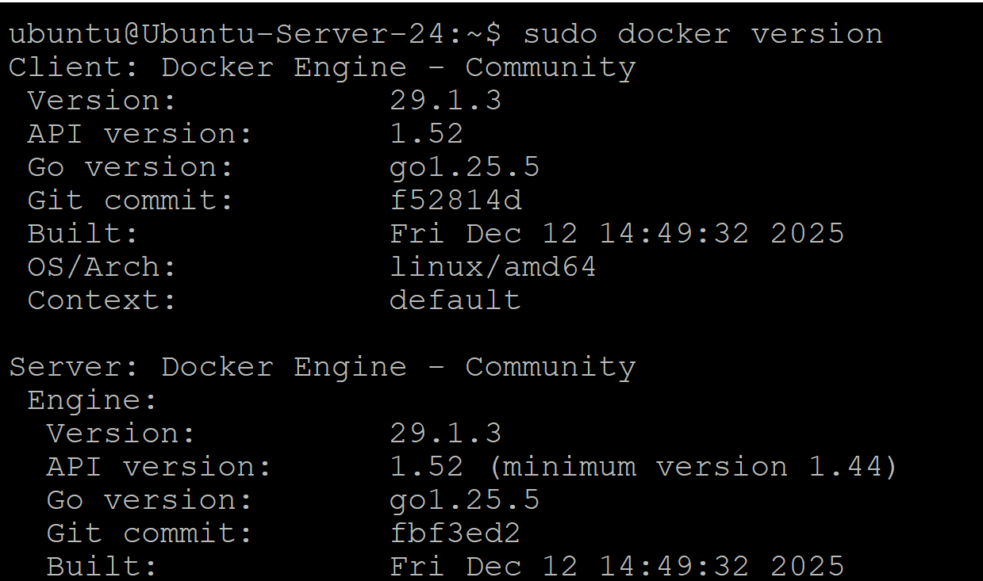
2. Verify Docker Installation
sudo docker version

Slide 8
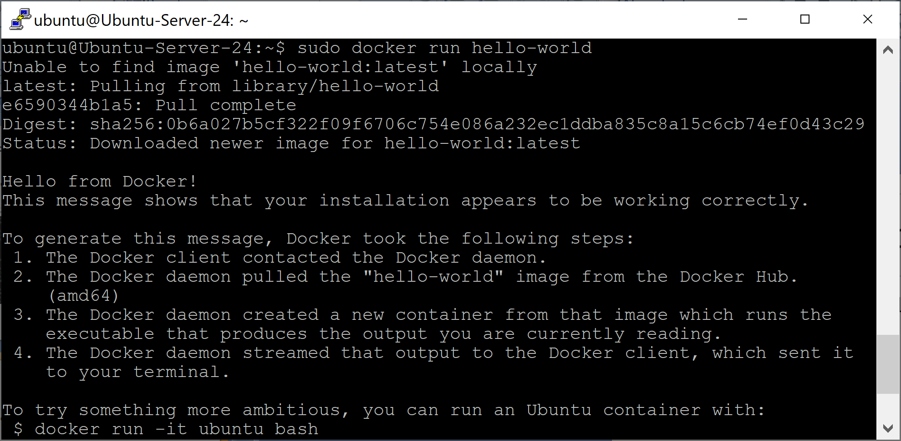
3. Run Hello World
sudo docker run hello-world

Slide 9
4. Avoid Using sudo
sudo usermod -aG docker $USER
newgrp docker
docker run hello-world

Slide 10
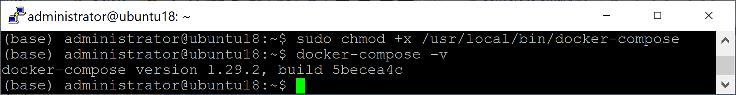
5. Install docker-compose
sudo curl -L "https://github.com/docker/compose/releases/download/1.29.2/docker-compose-$(uname -s)-$(uname -m)" -o /usr/local/bin/docker-compose
sudo chmod +x /usr/local/bin/docker-compose
docker-compose -v

Slide 11


Slide 12
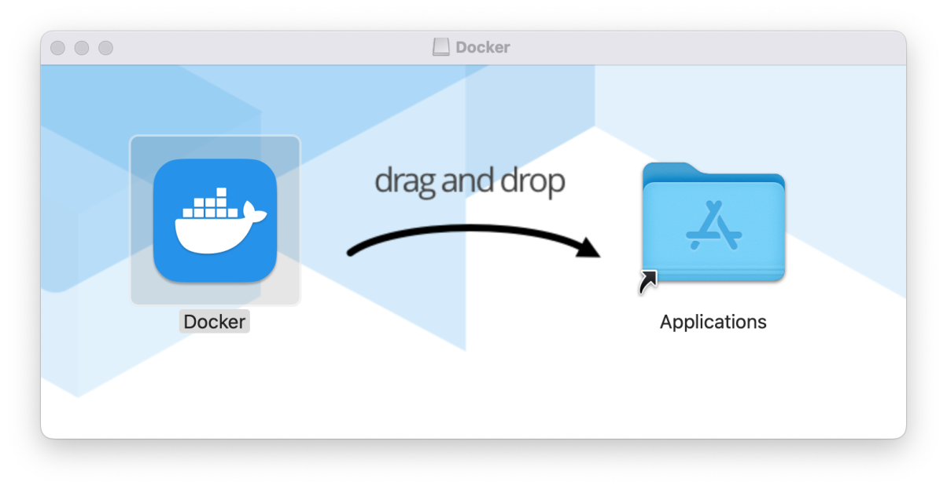
1. Install Docker on macOS
https://www.docker.com/products/docker-desktop/
Select Apple Silicon or Intel Chip, depending on your MacBook’s processor.

Slide 13
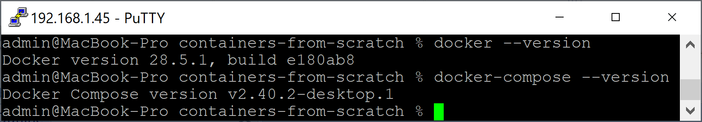
2. Verify Docker Installation
docker --version
docker-compose --version

Slide 14
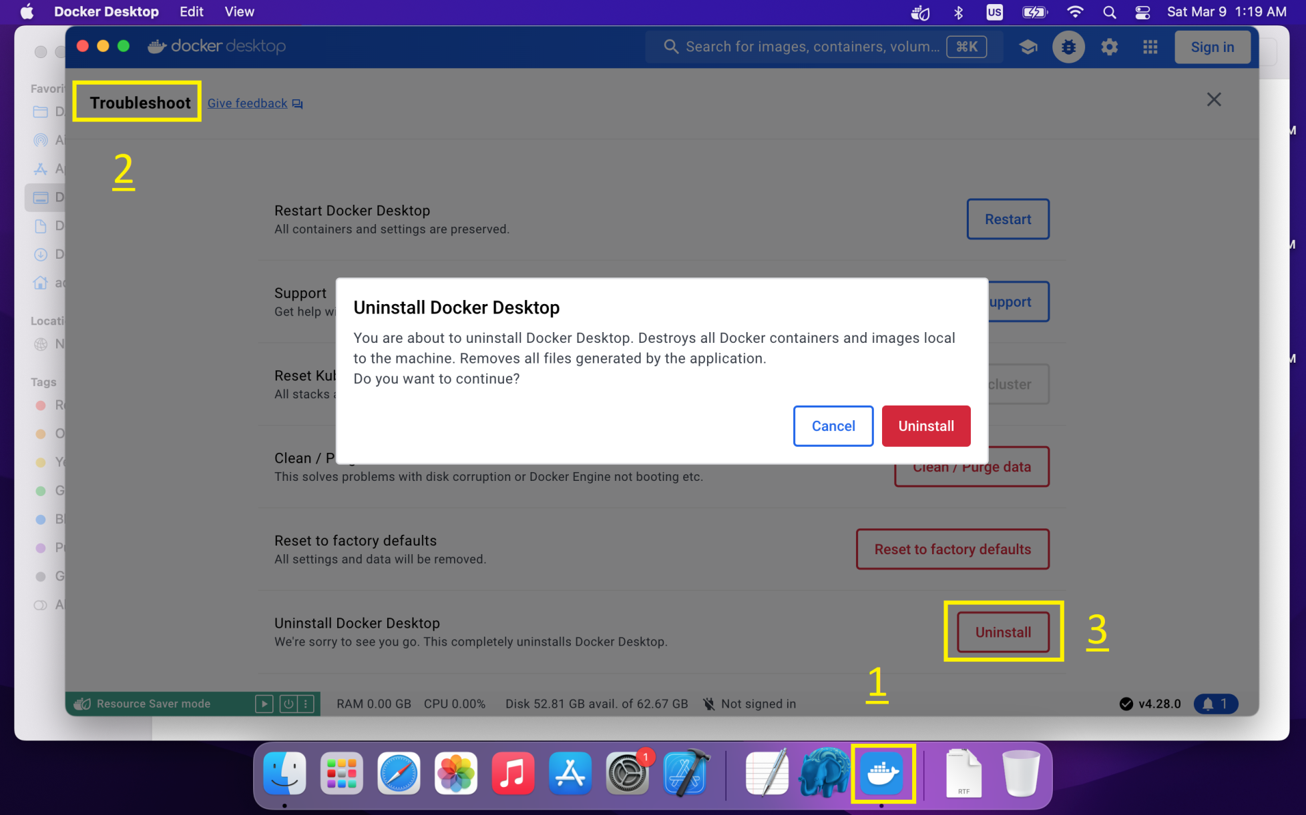
3. Uninstall Docker on macOS
https://docs.docker.com/desktop/uninstall/

Slide 15
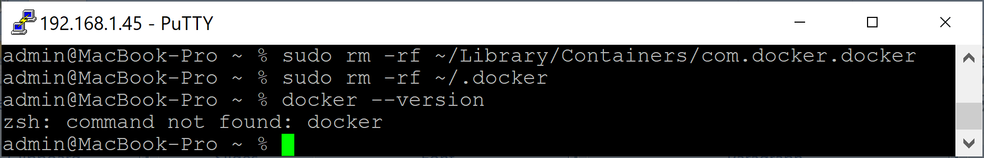
4. Remove Files
sudo rm -rf ~/Library/Group\ Containers/group.com.docker
sudo rm -rf ~/Library/Containers/com.docker.docker
sudo rm -rf ~/.docker
docker --version

Slide 17
When can you skip WSL?
You only run FROM mcr.microsoft.com/windows/servercore or similar in Dockerfiles
You're not planning to run anything based on Debian, Alpine, Ubuntu.

Slide 18
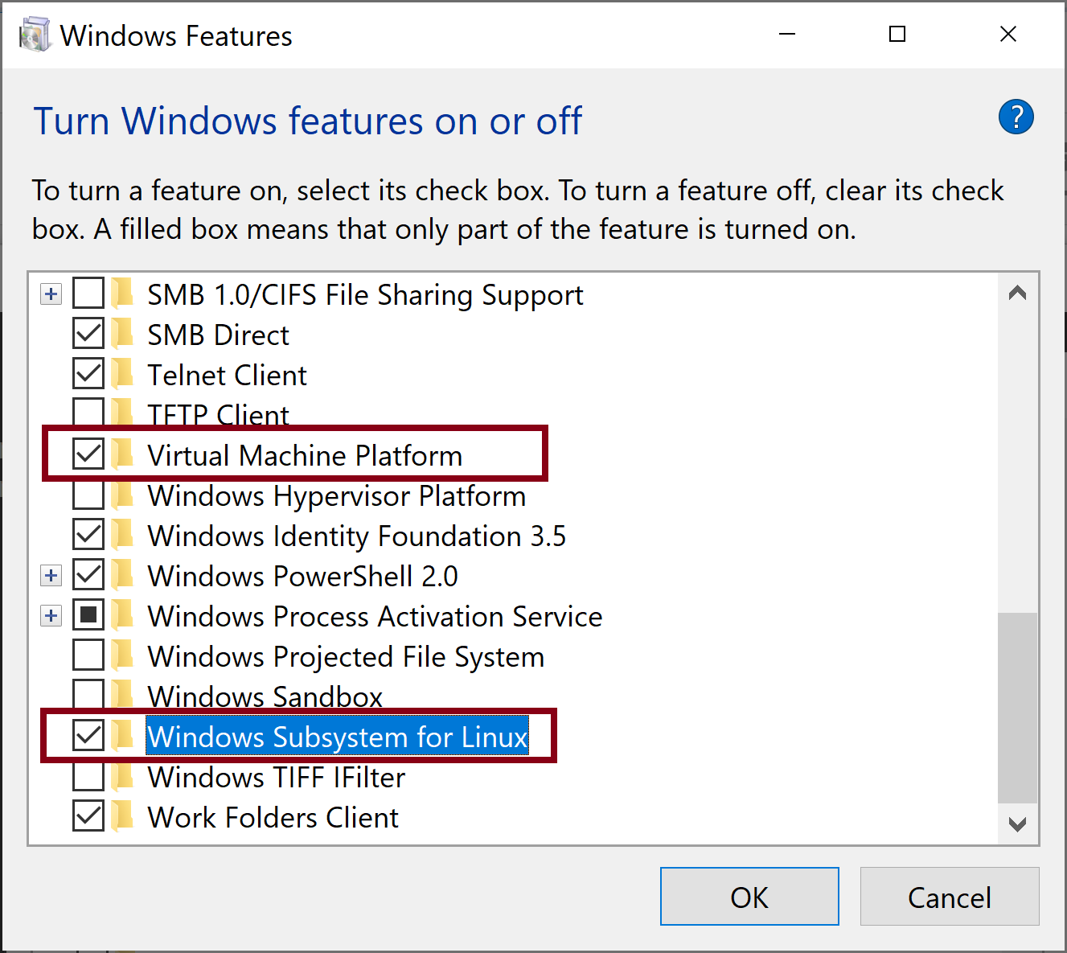
1. Enable Windows Subsystem for Linux
Search for "Turn Windows features on or off".
Use WSL 2 for Docker on Windows unless you have a very specific reason to prefer Hyper-V (e.g. more isolated VM environment).

Slide 19
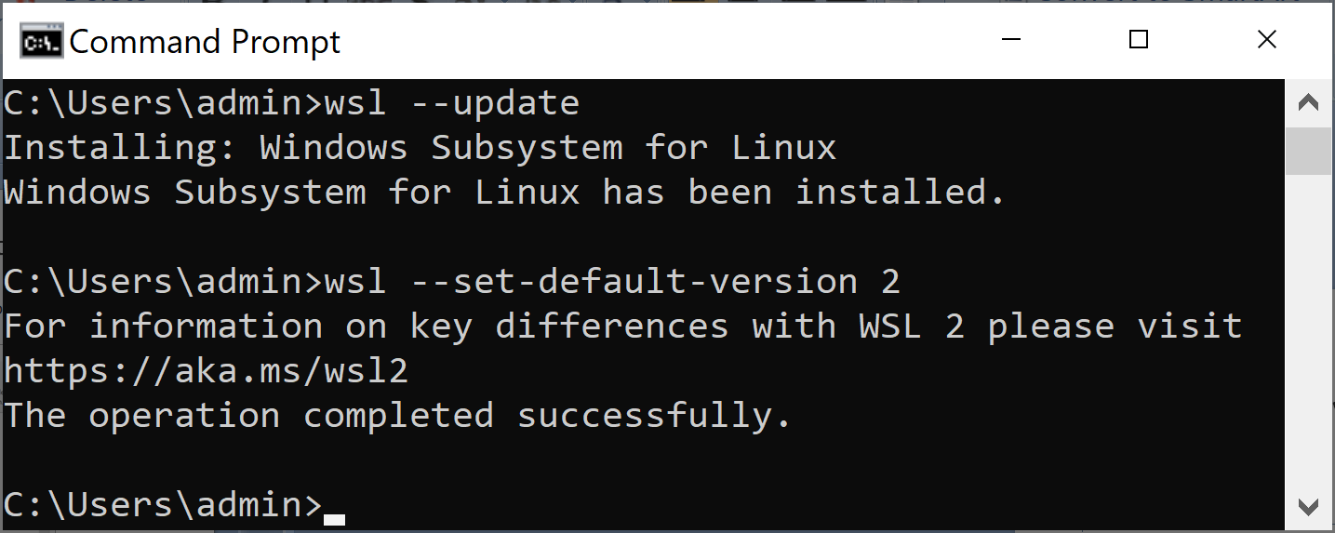
2. Verify WSL Version
wsl --status
wsl --update
wsl --set-default-version 2

Slide 20
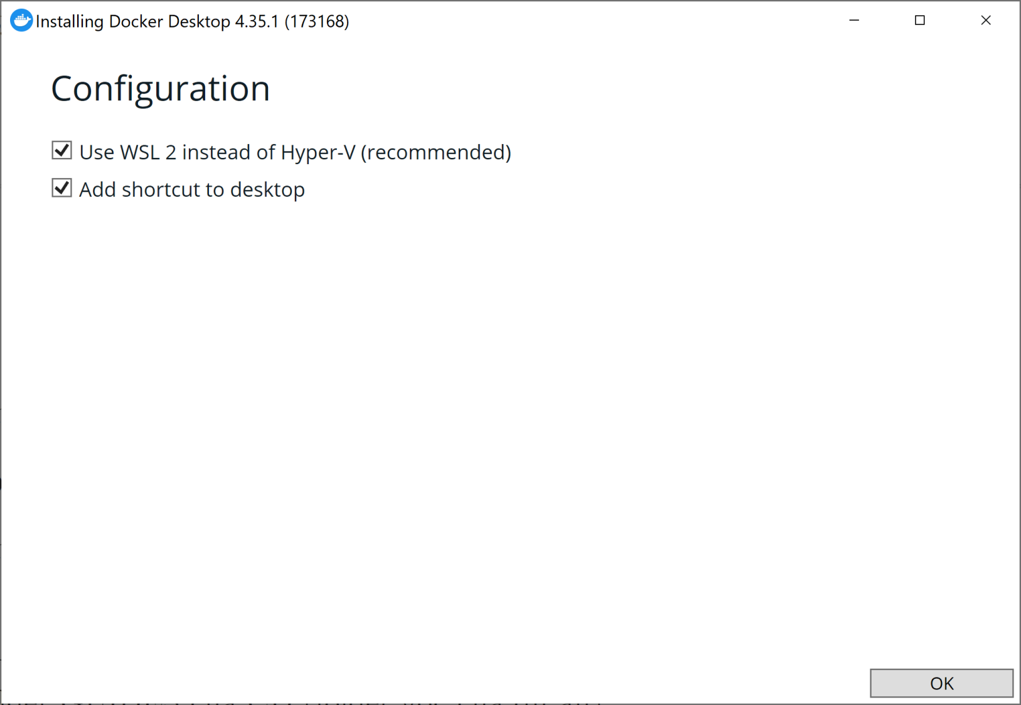
3. Install Docker Desktop

Slide 21
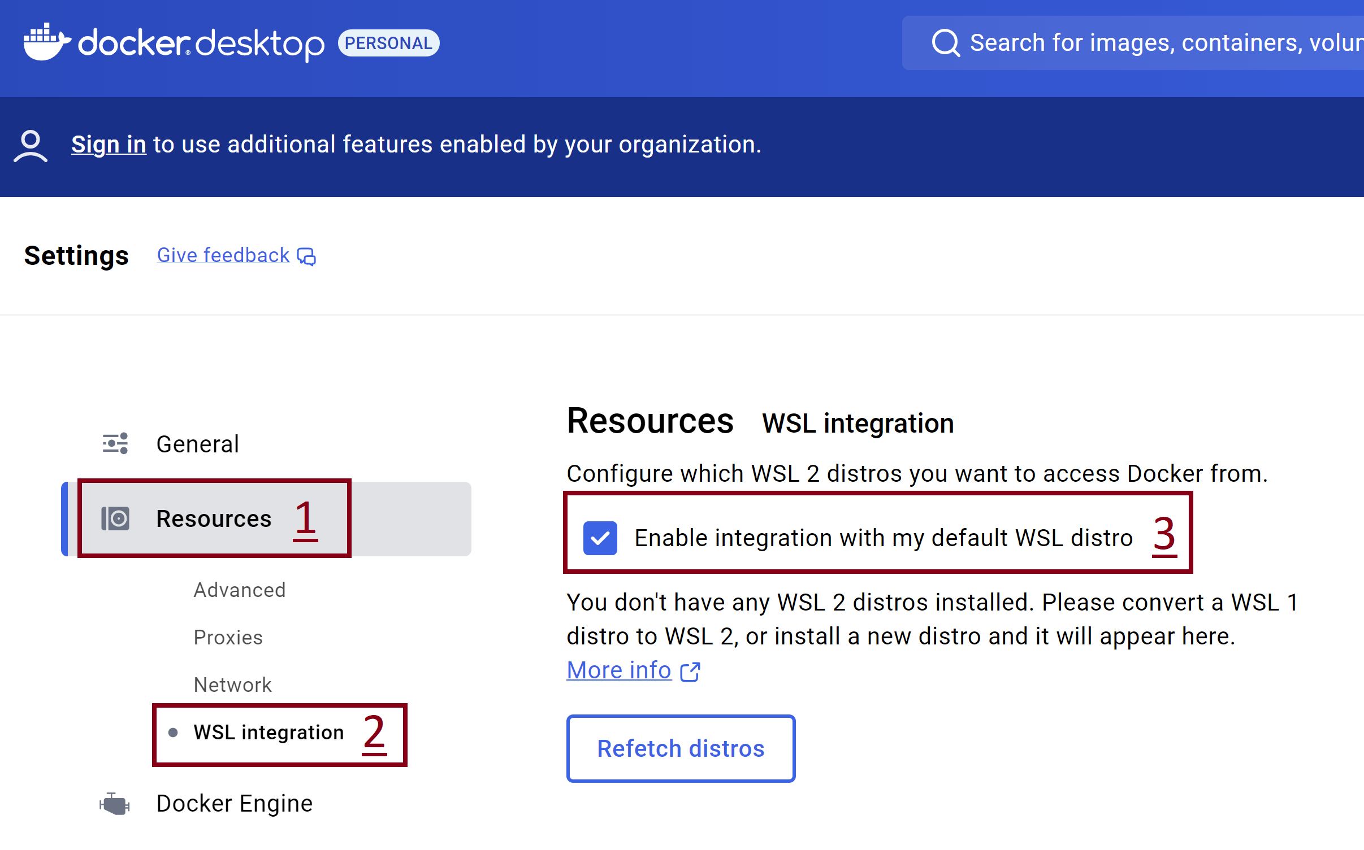
4. Confirm WSL Intergation

Slide 22
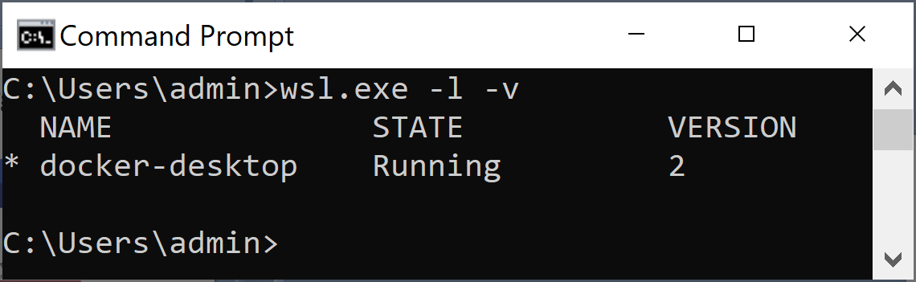
5. List all WSL Distributions
wsl.exe -l -v

Slide 23
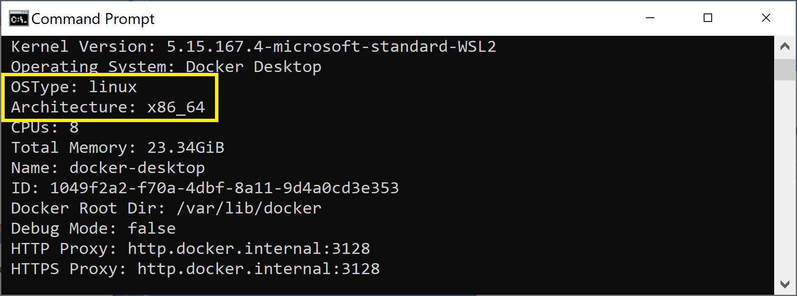
6. Verify OS Type and Architecture
Purpose: For building images later.

Slide 25
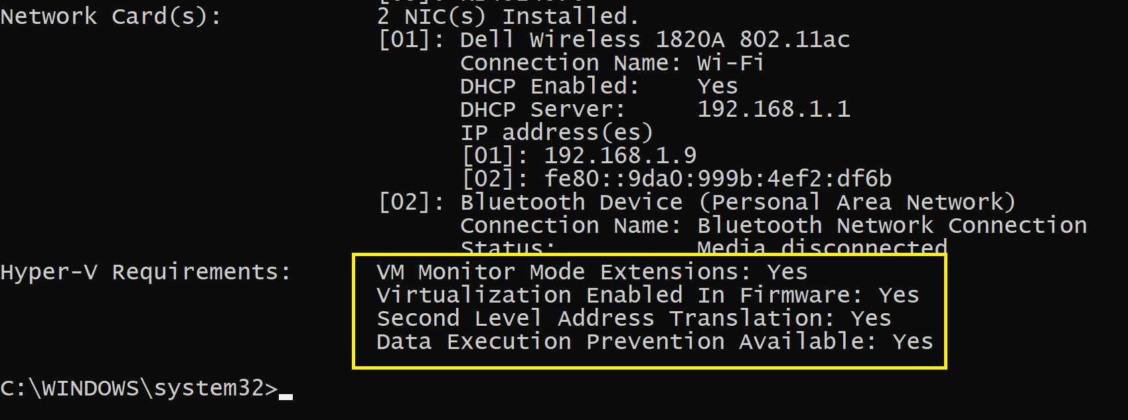
1. Verify Hardware Compatibility on Windows 10
systeminfo

Slide 26
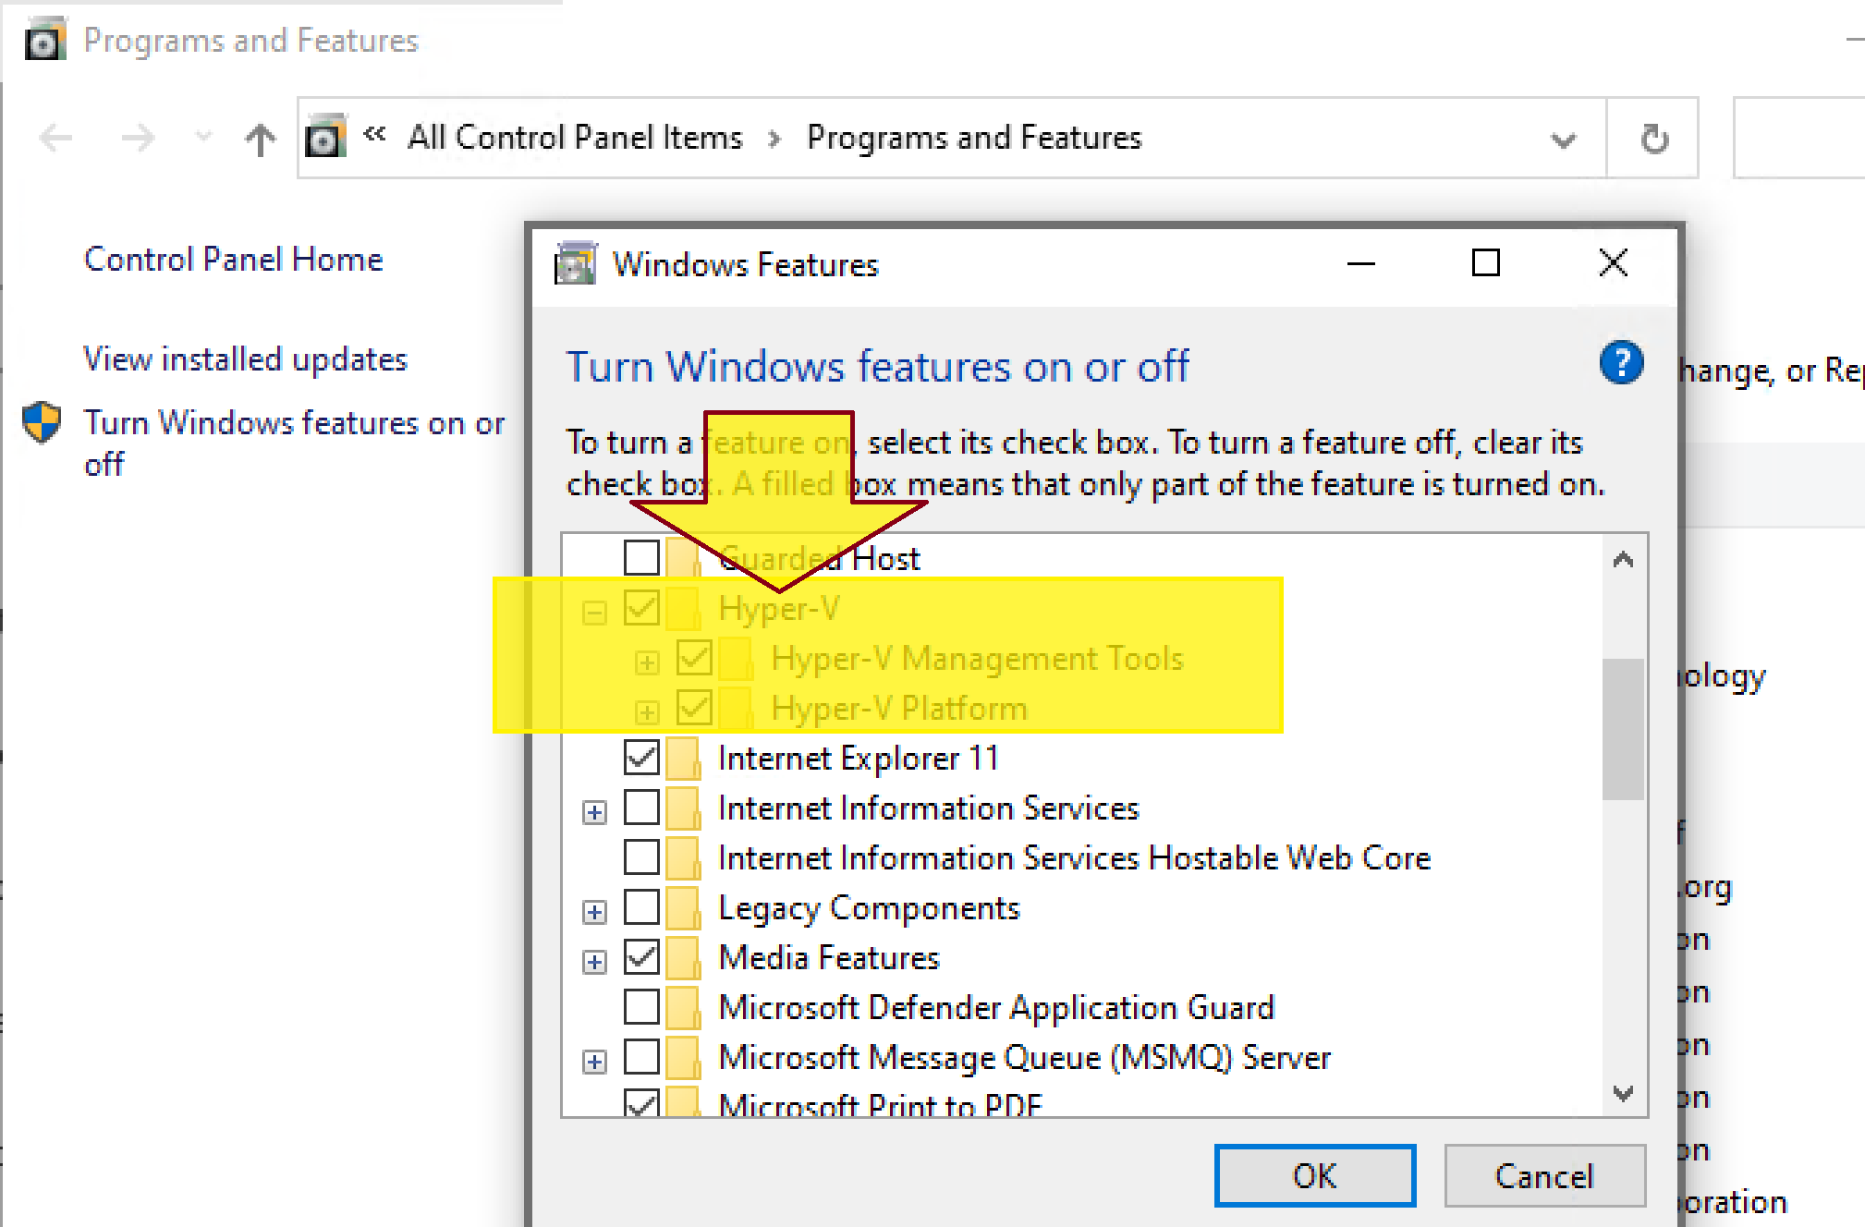
2. Enable Hyper-V Features

Slide 27
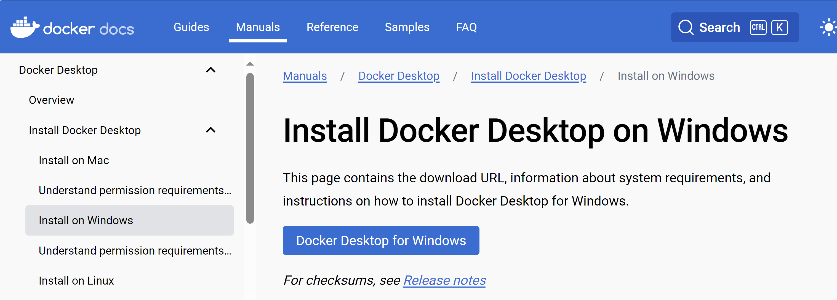
3. Install Docker Desktop
https://docs.docker.com/desktop/install/windows-install/

Slide 28
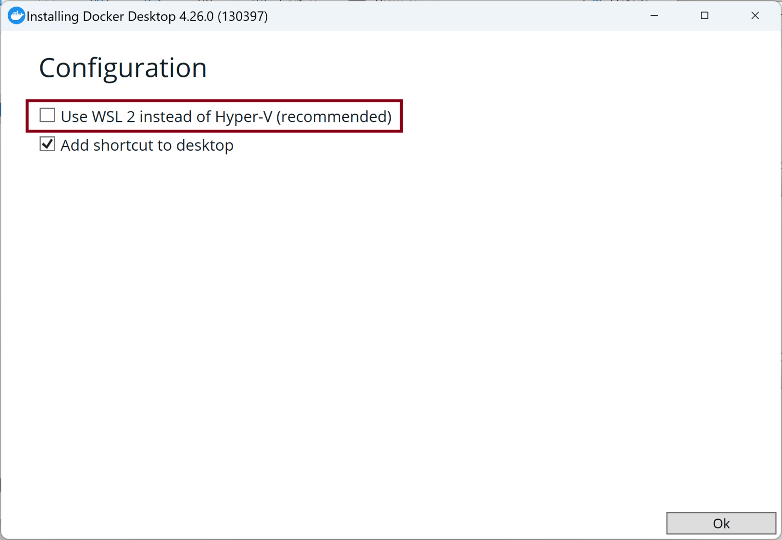
4. Select Options

Slide 29
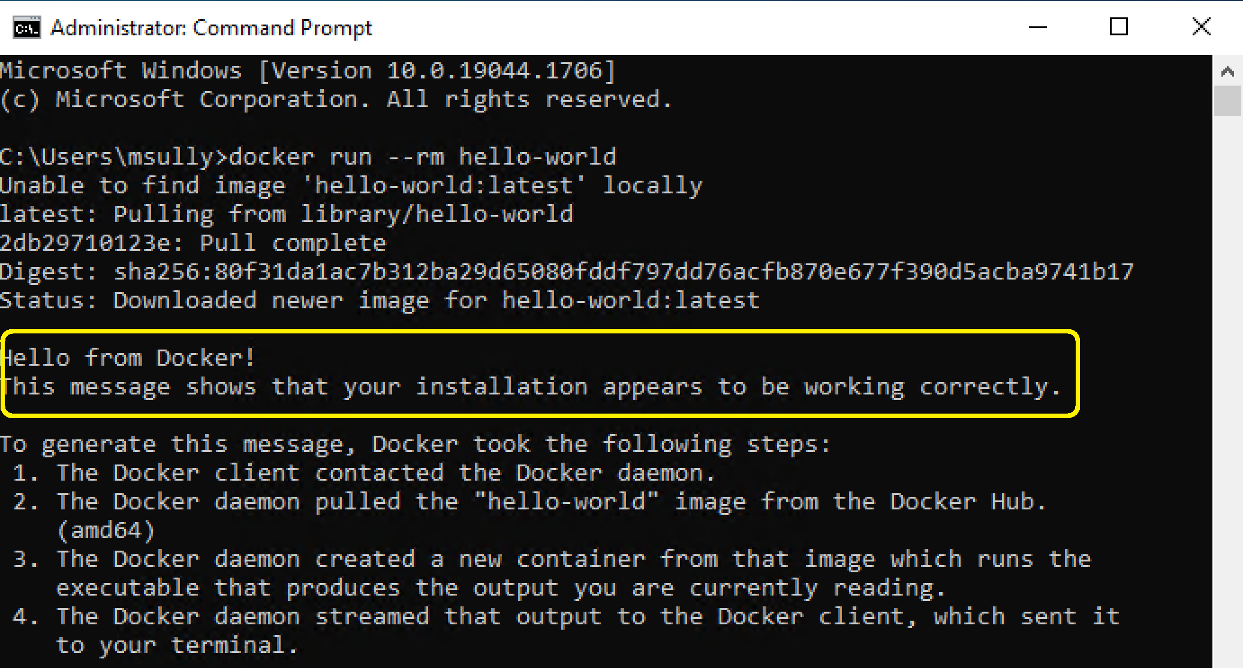
5. Verify Docker Installation
docker run --rm hello-world

Slide 31
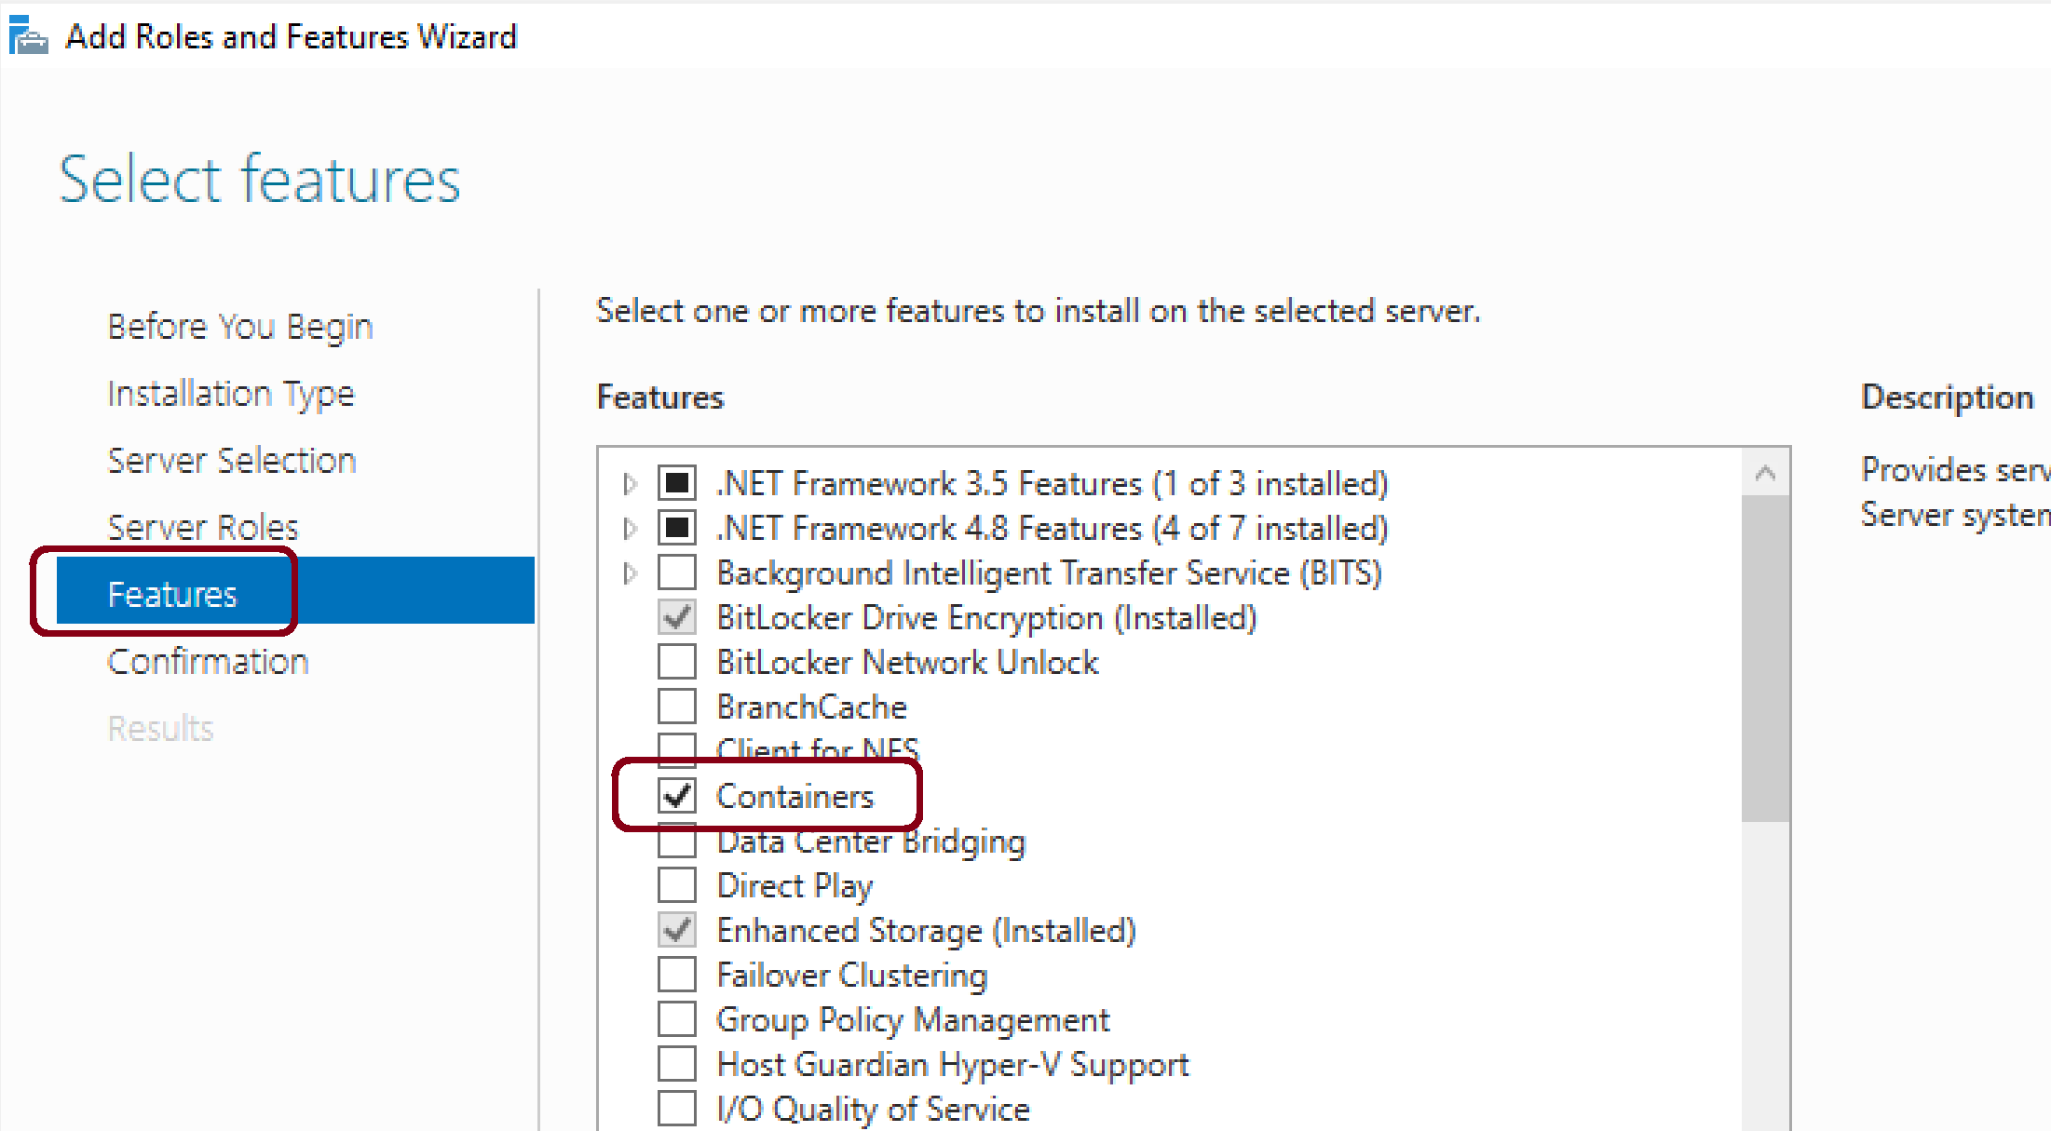
1. Install Server 2022 Containers Feature

Slide 32
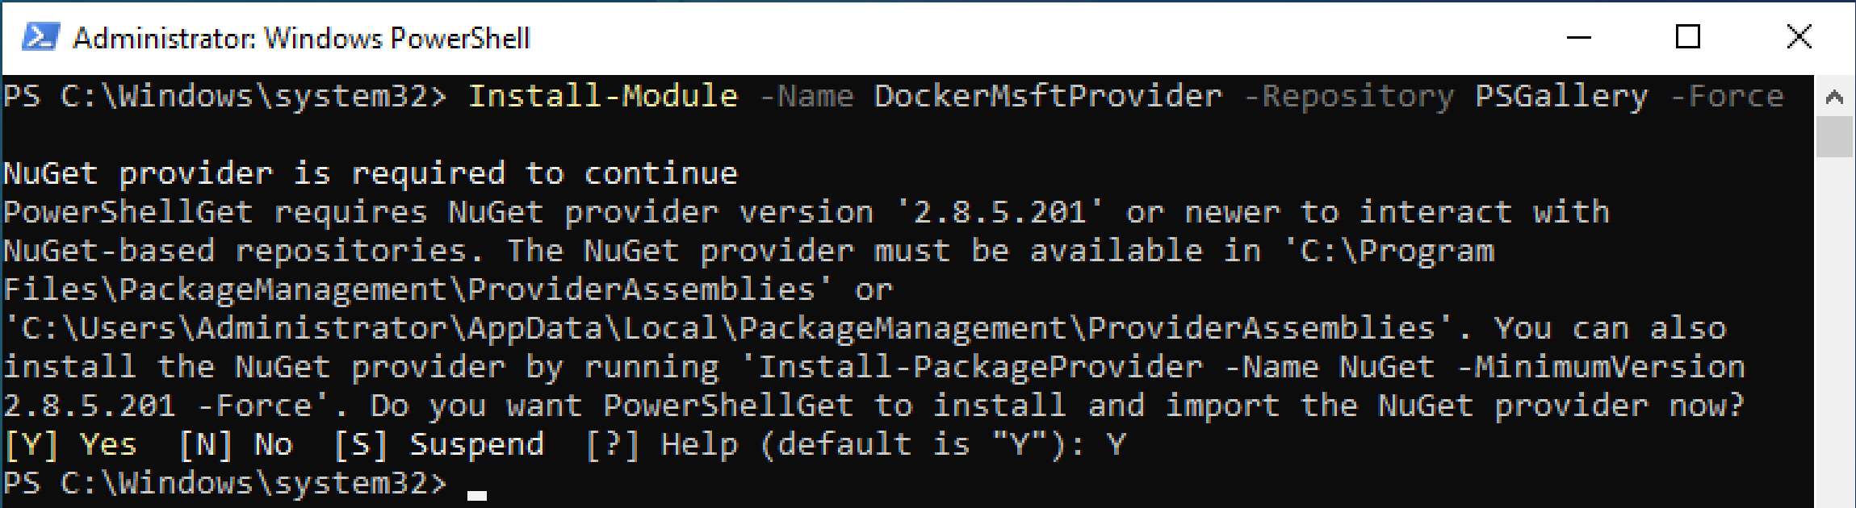
2. Install the Docker Microsoft Package Provider Module
Open PowerShell as Administrator.
Install-Module -Name DockerMsftProvider -Repository PSGallery -Force
Type Y, press Enter.

Slide 33
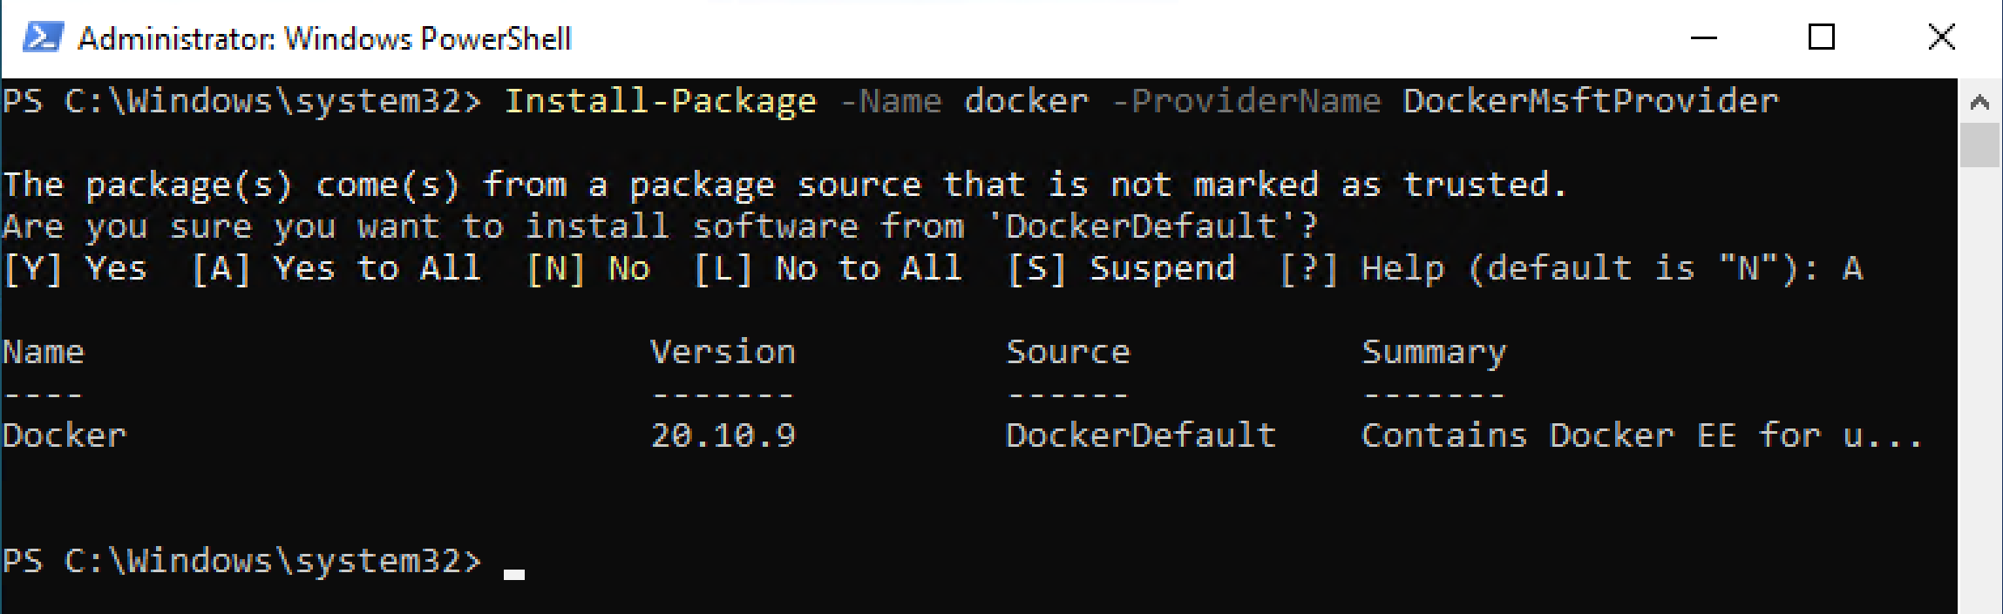
3. Install the latest Docker Version
Open PowerShell as Administrator.
Install-Package -Name docker -ProviderName DockerMsftProvider
Type A, press Enter.
Restart the Computer: Restart-Computer -Force

Slide 34
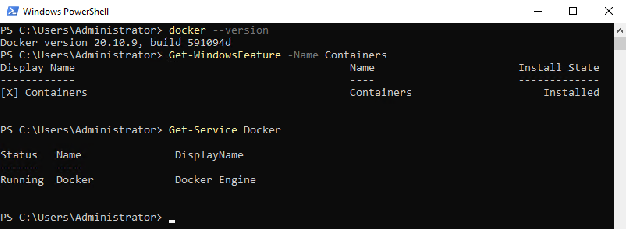
4. Verify Docker Installation
docker --version
Get-WindowsFeature -Name Containers
Get-Service Docker

Slide 35
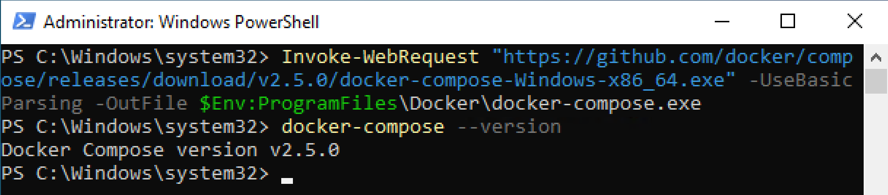
5. Install Docker Compose
Invoke-WebRequest "https://github.com/docker/compose/releases/download/v2.5.0/docker-compose-Windows-x86_64.exe" -UseBasicParsing -OutFile $Env:ProgramFiles\Docker\docker-compose.exe
docker-compose --version

Slide 36
6. Uninstall Docker
Uninstall-Package -Name docker -ProviderName DockerProvider
Uninstall-Module -Name DockerProvider
https://stackoverflow.com/questions/45554311/docker-on-windows-in-production
The major problem was with the docker swarm. The overlay networking with routing mesh was not working properly. So we had to fall back to containers with docker-compose and manual service discovery, which kinda beats the purpose of docker.
Another problem was that we did not have nested virtualization (i.e. cannot run moby) due to CPU issues, and WSL2 with support for Docker is not available on WS19 LTSC editions. So I had to write our own images for many stuff that we use. Like Jenkins, Redis, etc. But obviously keeping them up to date and tidy was a huge work and I did not have much time to invest.

Slide 37

Thank You & See You Again

